Slide 1
How transferable are features in deep neural networks?
报告人：罗宏涛 2020.11.3

Slide 2
How transferable are features in deep neural networks?
Motivation
*Experiments
Conclusion

Slide 3
Motivation

Slide 4
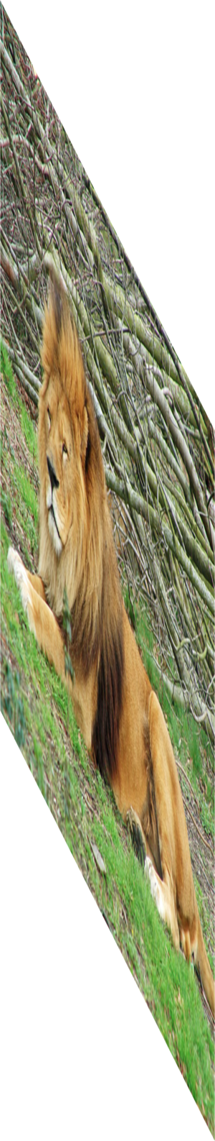
AlexNet
Lion
Image
labels
Krizhevsky, Sutskever, Hinton — NIPS 2012
Notes:
At NIPS two years ago, Alex Krizhevsky et al demonstrated a convolutional neural network that they successfully trained on the “ImageNet Large Scale Visual Recognition Challenge 2012 classification dataset”.

Slide 5



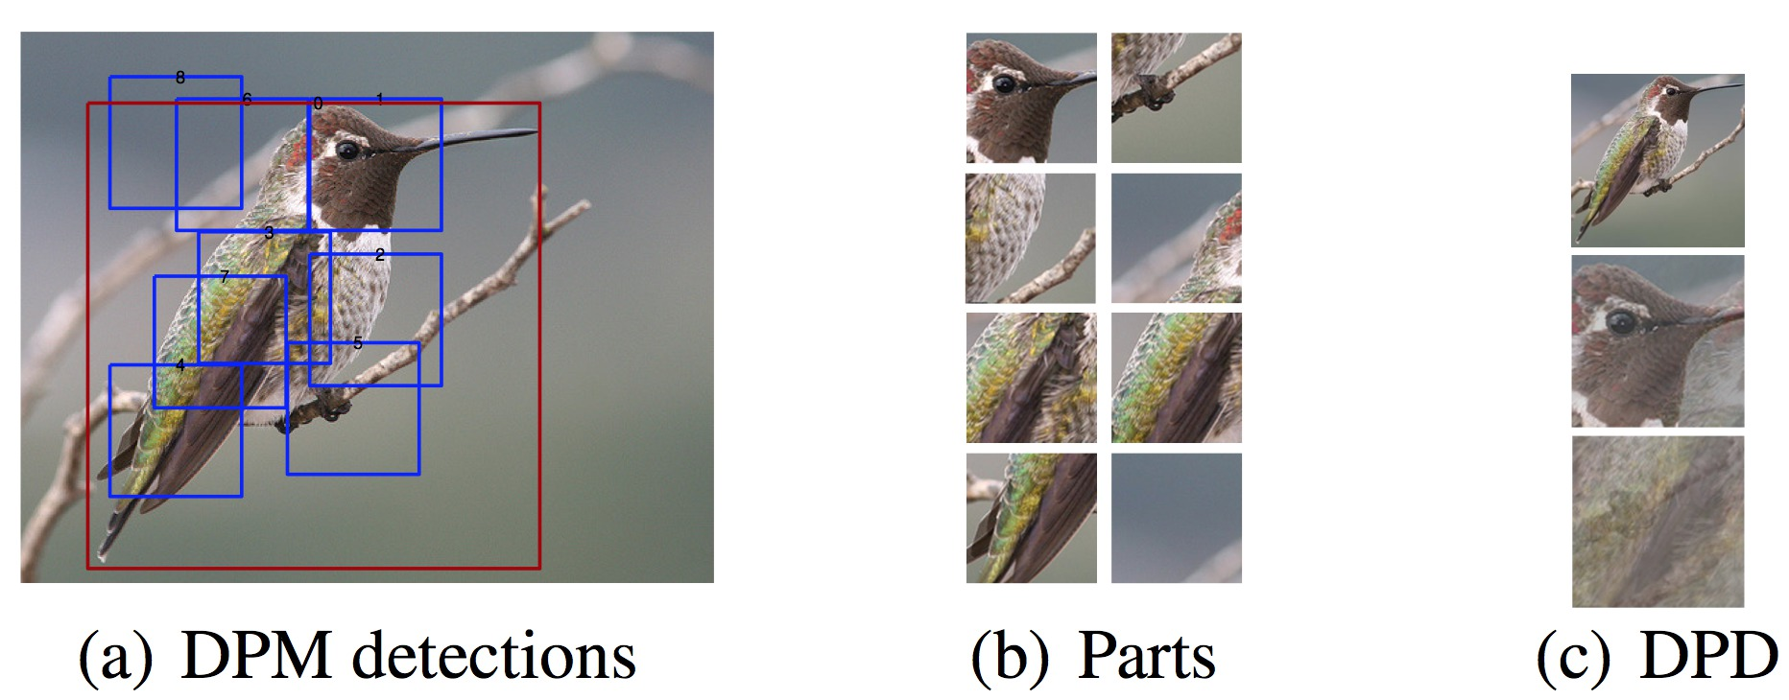
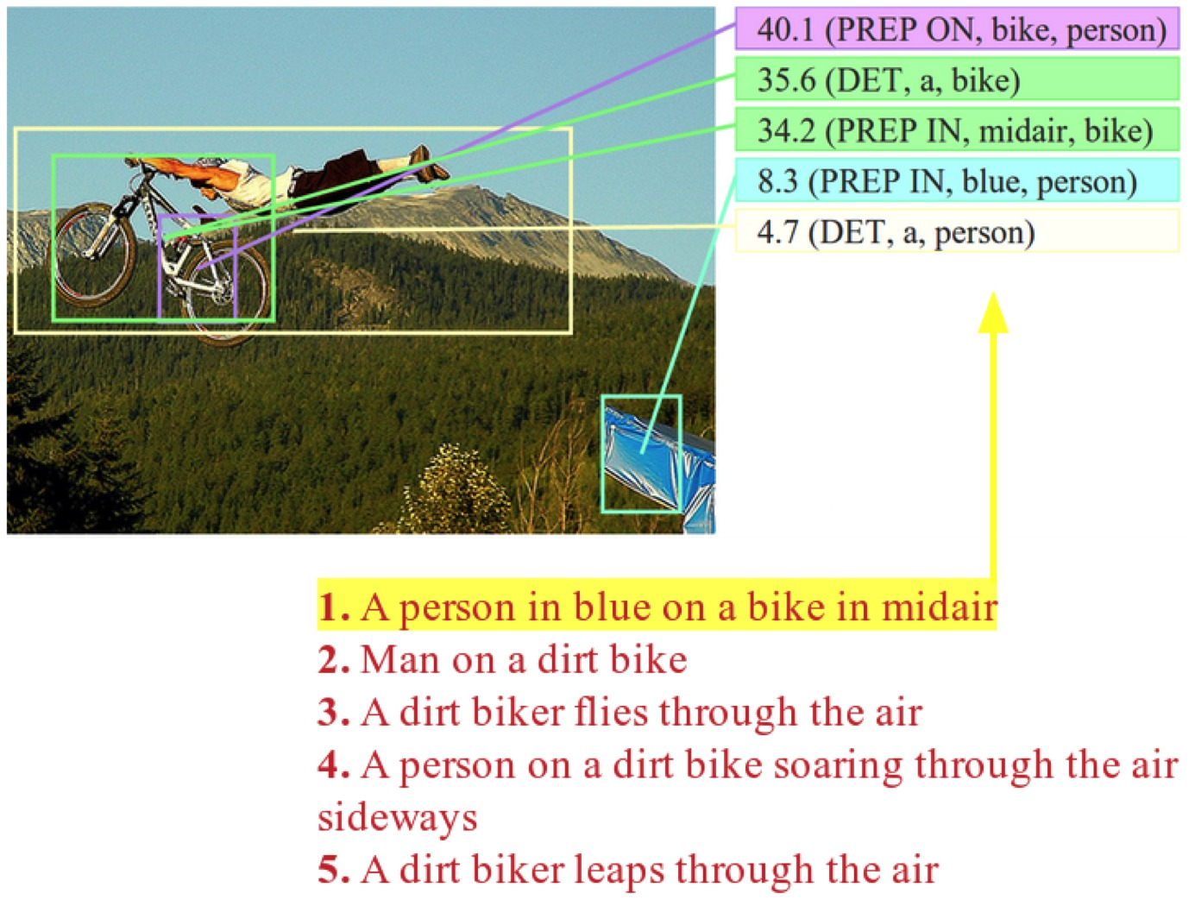
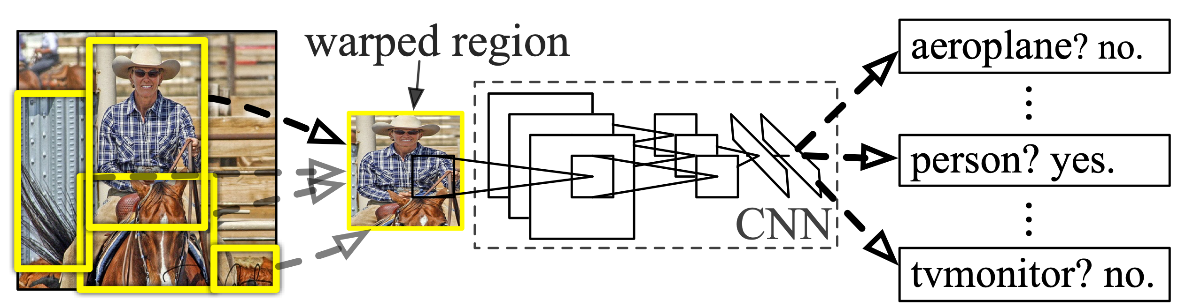
DeCAF
Donahue, Jia, et al. arXiv 2013
R-CNN
Girshick et al., CVPR 2014
Deep Fragment Embeddings
Karpathy et al. NIPS 2014
Image
labels

Slide 6



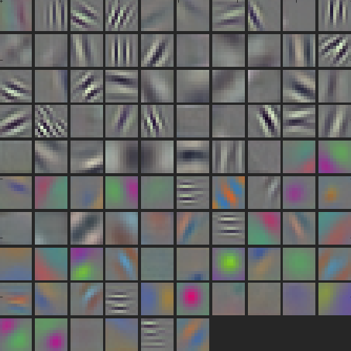
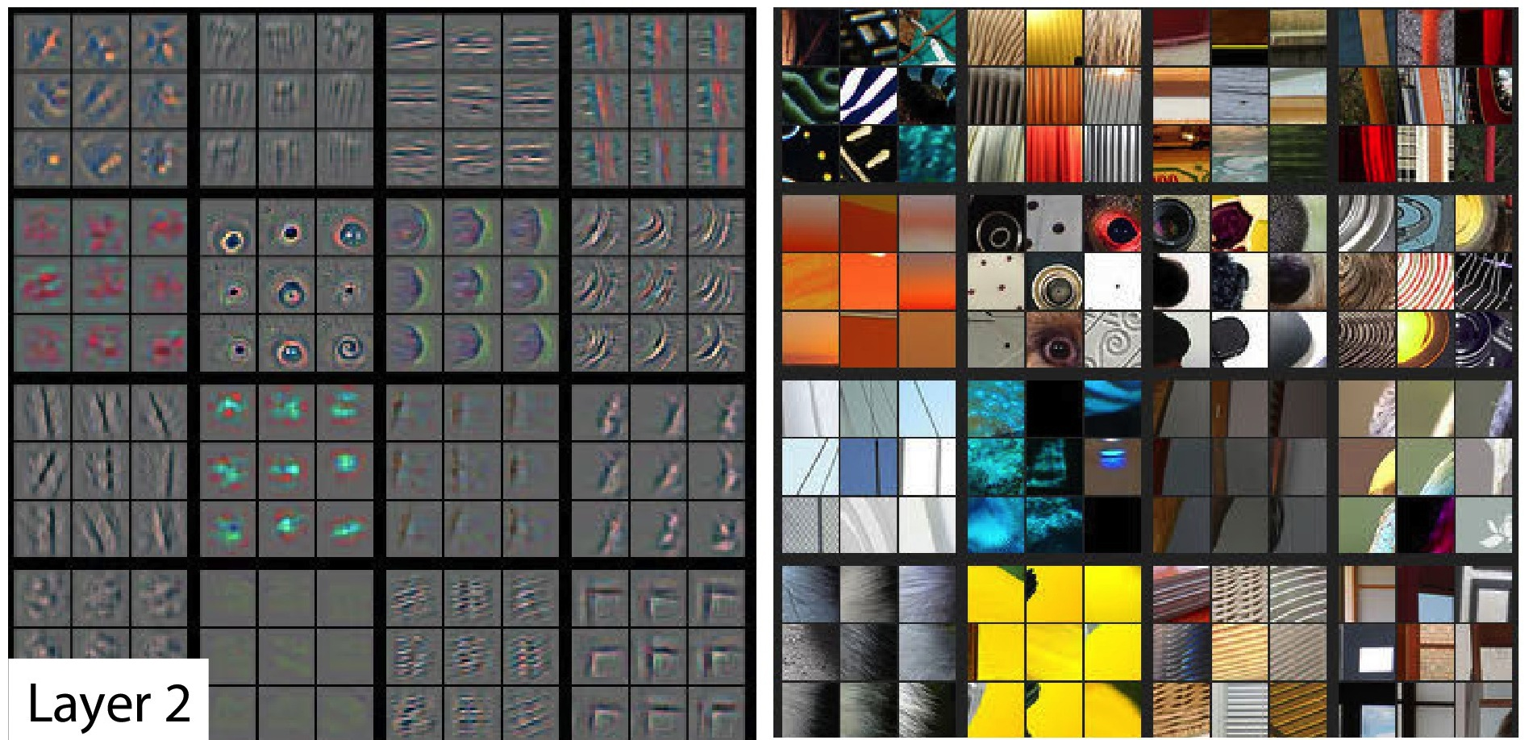
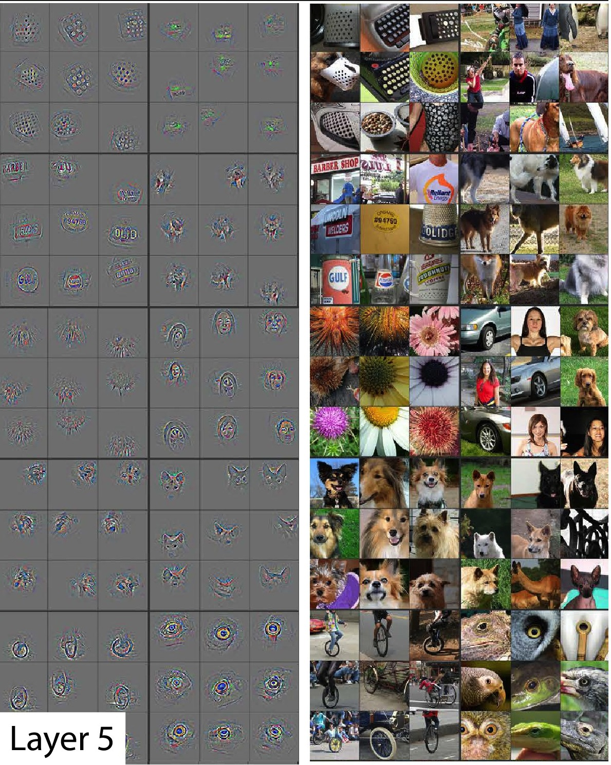
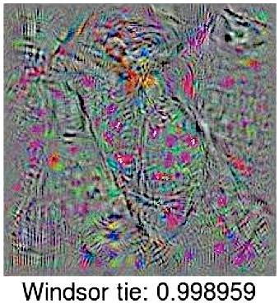
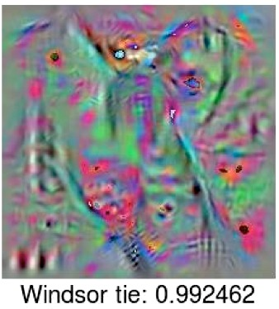
Layer 1
Gabor +
color blobs
Layer 2
Layer 5
Last
Layer
Zeiler et al.
arXiv 2013, ECCV 2014
Nguyen et al.
arXiv 2014
Notes:
clear THAT they work, but not as clear WHY or HOW.
WHAT’s going on in the middle?
LET’S think about what we DO KNOW.

Slide 8

general
??
??
Can we quantify the degree to which a particular layer is general or specific?
Does the transition occur suddenly at a single layer?
Where does the transition take place?
??
Lion
specific
Layer number

Slide 9
Experiments

Slide 10
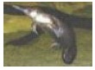
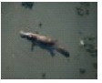
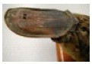
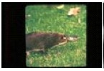
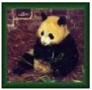
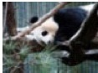
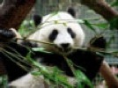
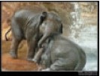
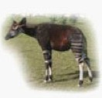
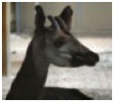
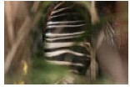
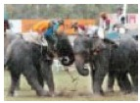
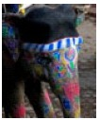
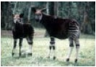
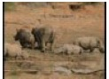
ImageNet
dataset
A
500 Classes
dataset
B
1000 Classes
500 Classes
Deng et al., 2009
Notes:
okapi

Slide 11
A Images
A Labels
Train using Caffe framework (Jia et al.)
500 Classes

Slide 12
A Images
A Labels
Train using Caffe framework (Jia et al.)
500 Classes
Notes:
train using the Caffe

Slide 13
A Images
A Labels
Train using Caffe framework (Jia et al.)
500 Classes

Slide 14
baseA
A Images
baseB
B Images

Slide 15
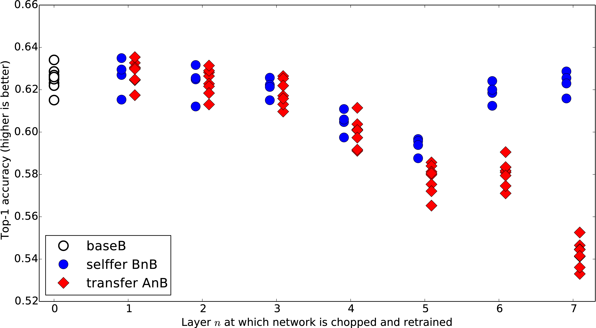

Slide 16
A Images
A Labels

Slide 17
B Images
B Labels

Slide 18

transfer
AnB
Compare to
B Images
B Labels
baseB

Slide 19
Notes:
FIRST layers generic for this A / B combination
OVERALL drop by the end is not large! (MANY RELATED CATEGORIES)
CURIOUS BUMP IN MIDDLE

Slide 20
B Images
B Labels

Slide 21
B Images
B Labels

Slide 22
selffer
BnB
B Images
B Labels

Slide 24
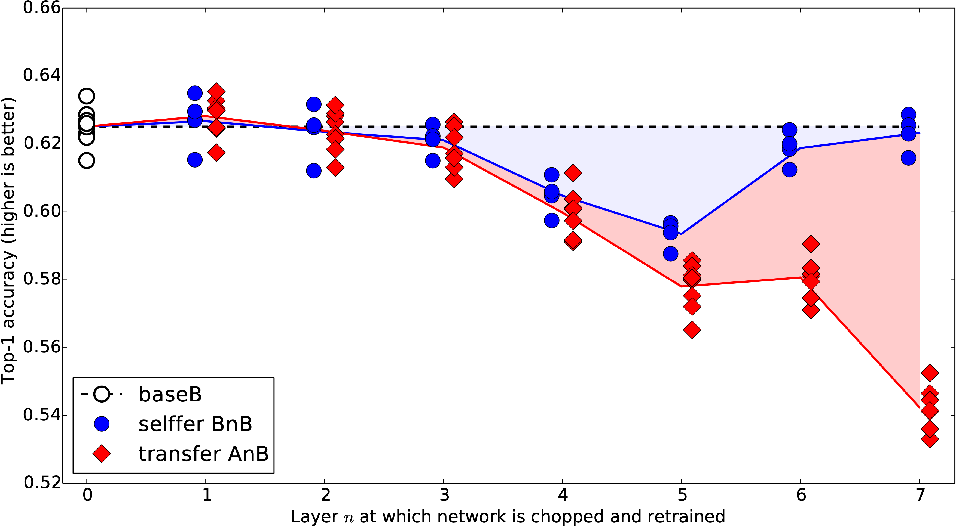

Slide 25
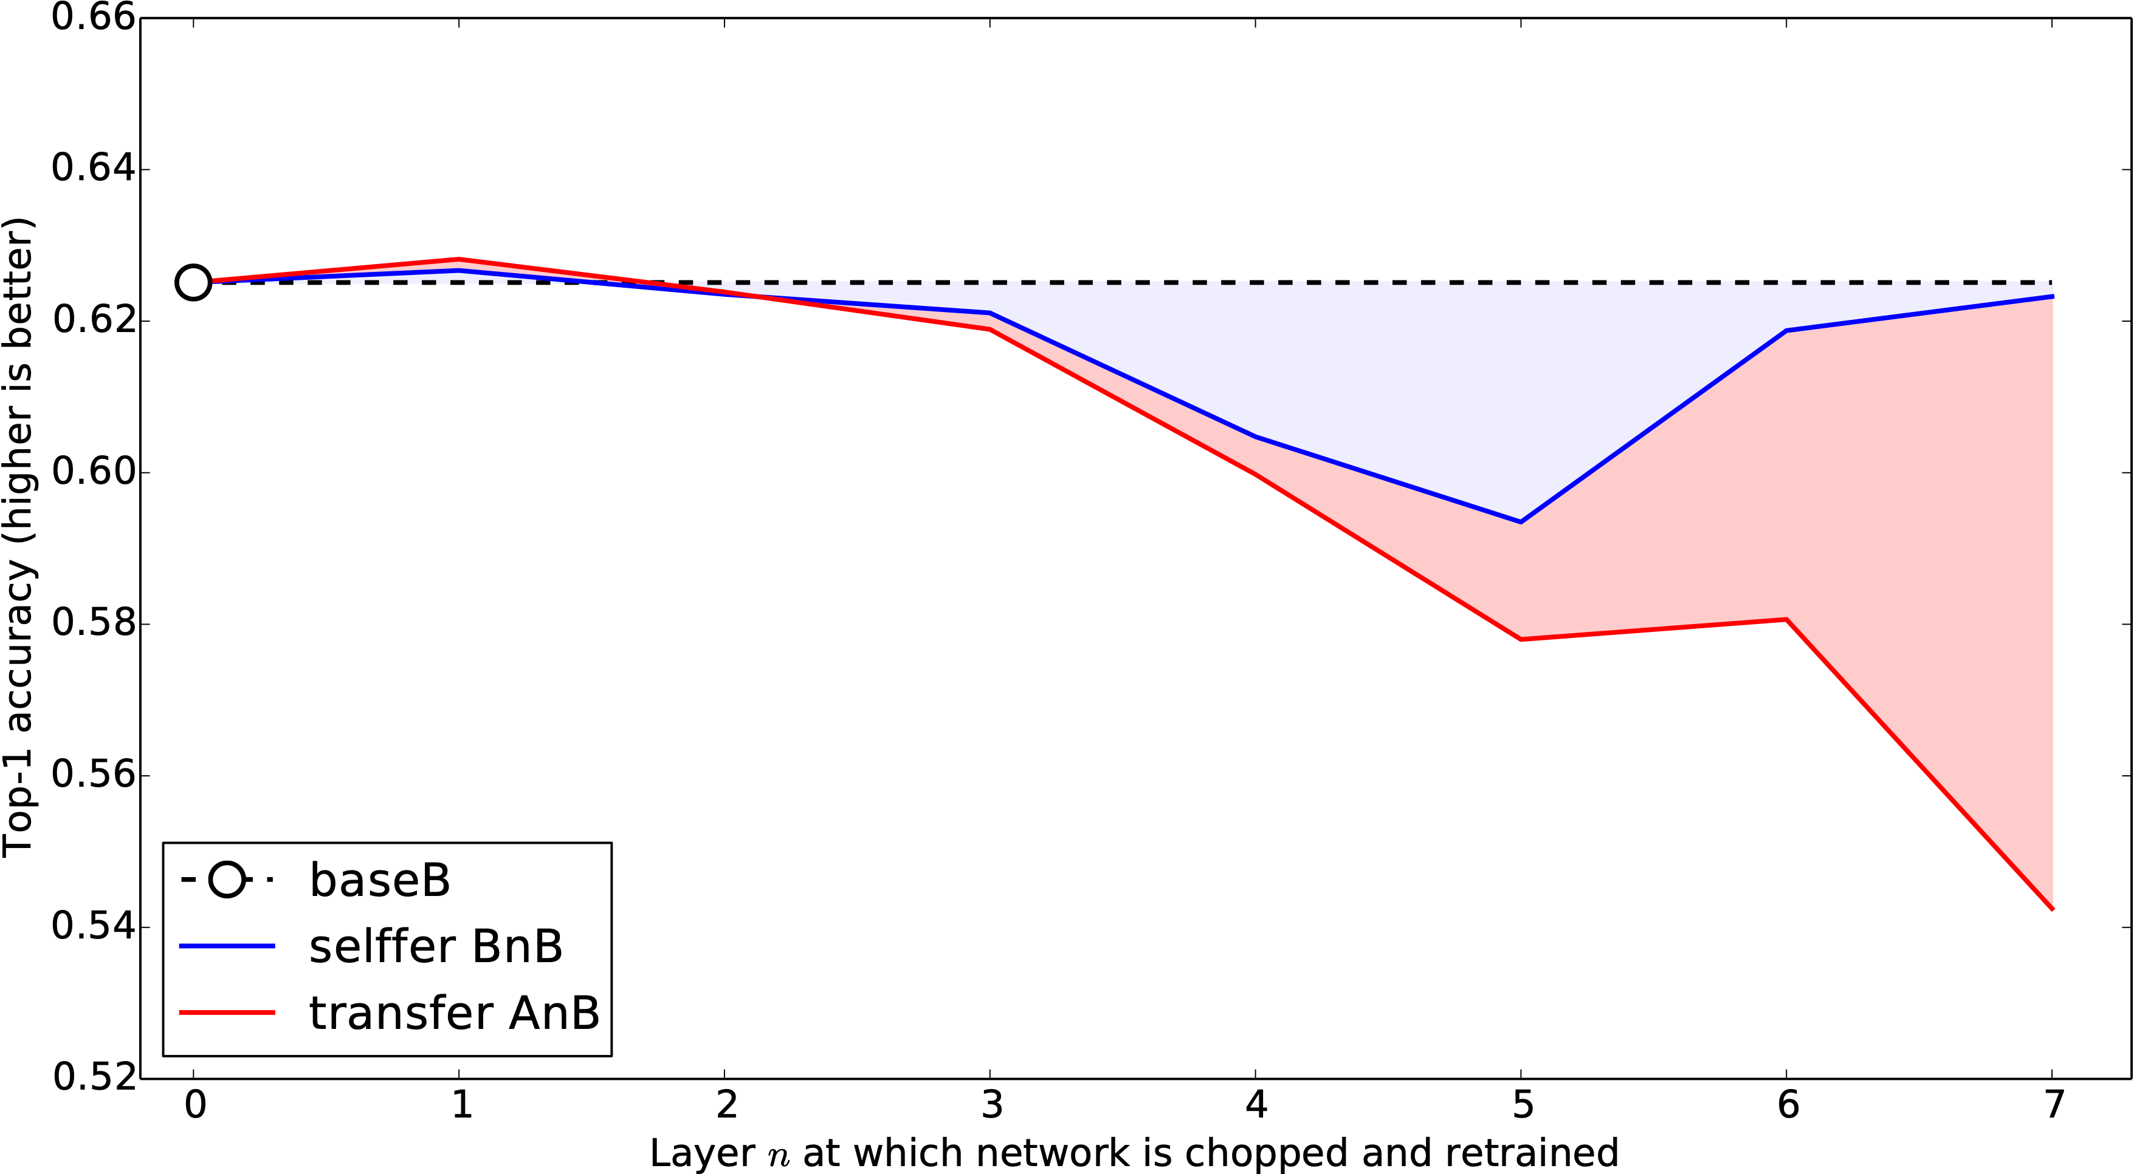
Performance drops due to...
Fragile
co-adaptation
Representation
specificity
Notes:
Not previously shown

Slide 26
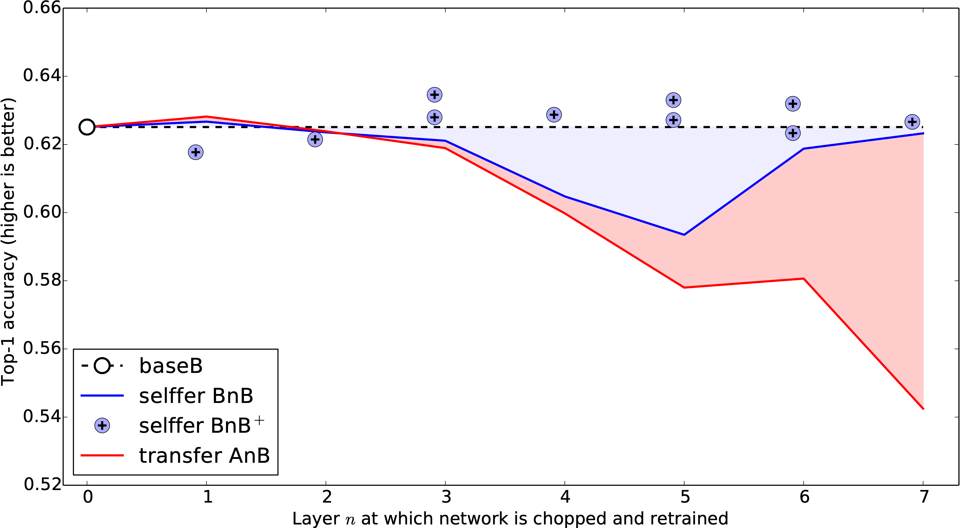
Notes:
Not previously shown

Slide 27
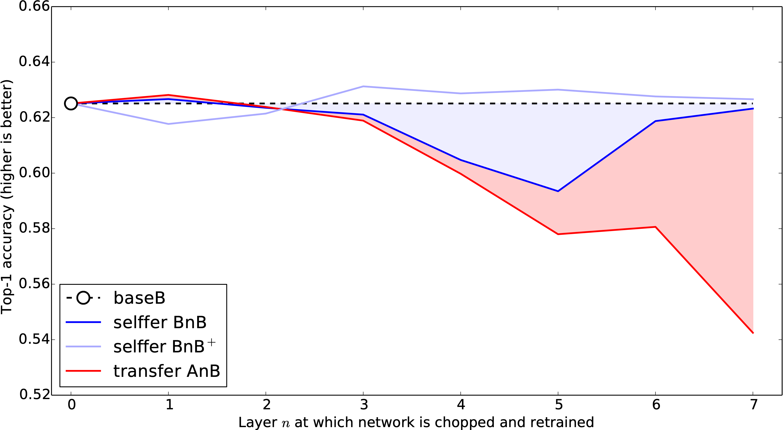
Notes:
Not previously shown

Slide 28
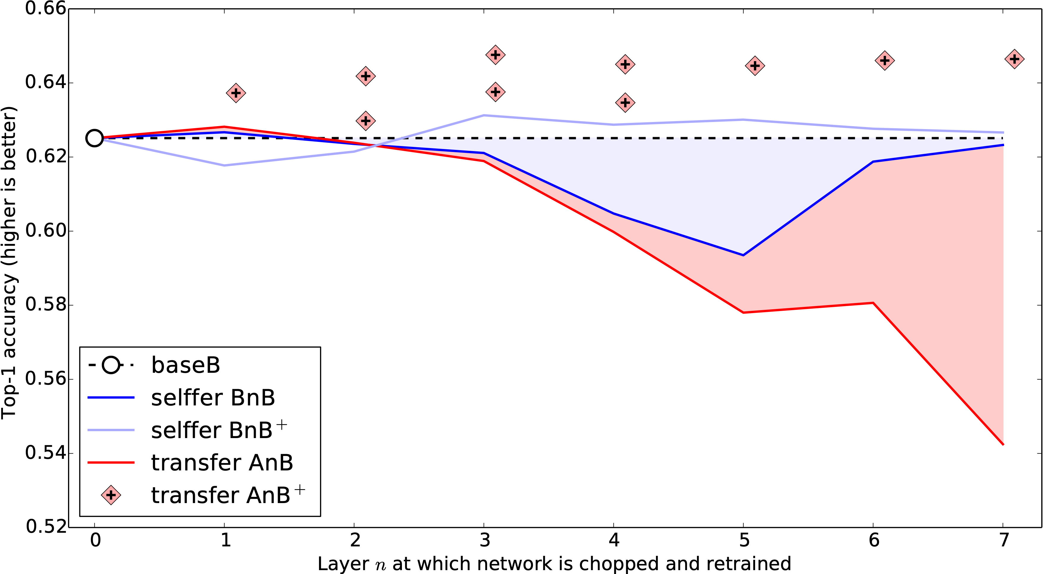
Notes:
Not previously shown

Slide 29
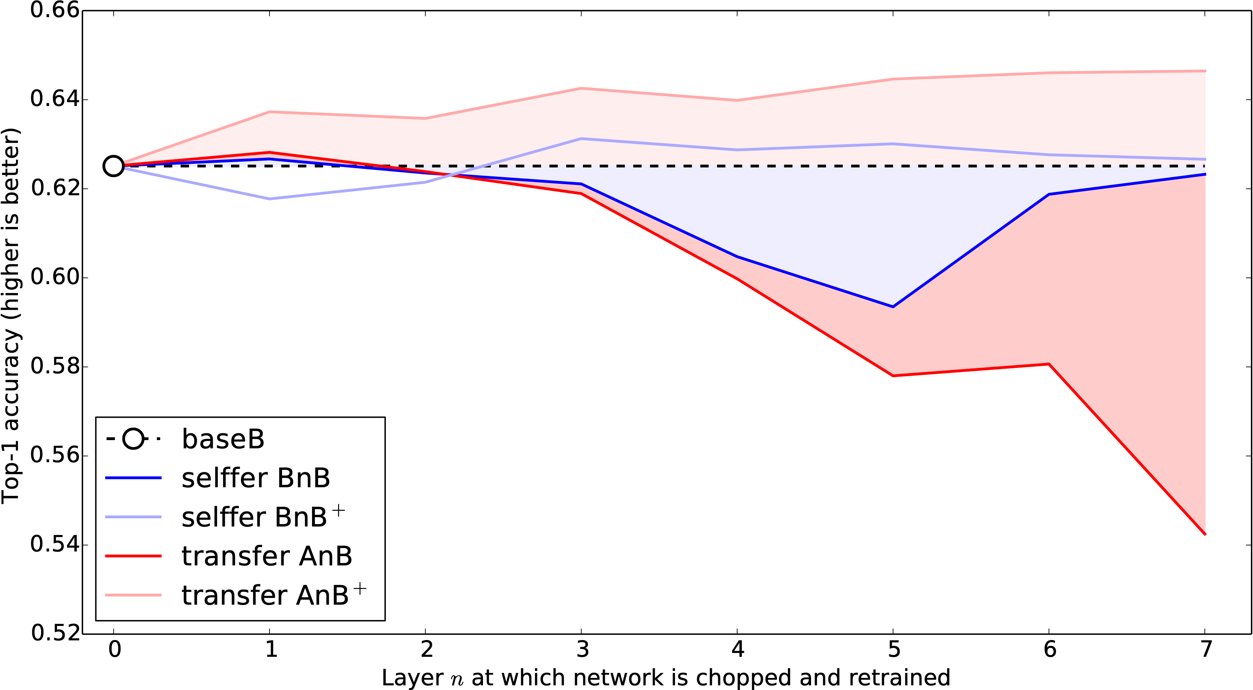
Notes:
Not previously shown

Slide 30
Transfer + fine-tuning improves generalization
Notes:
Not previously shown

Slide 31
ImageNet has many related categories...
Dataset A: random
Dataset B: random
gecko
garbage truck
toucan
fire truck
radiator
binoculars
baseball
lion
panther
bookshop
rabbit
gorilla

Slide 32
ImageNet has many related categories...
Dataset A: man-made
Dataset B: natural
garbage truck
gorilla
fire truck
gecko
radiator
toucan
baseball
rabbit
binoculars
panther
bookshop
lion

Slide 33
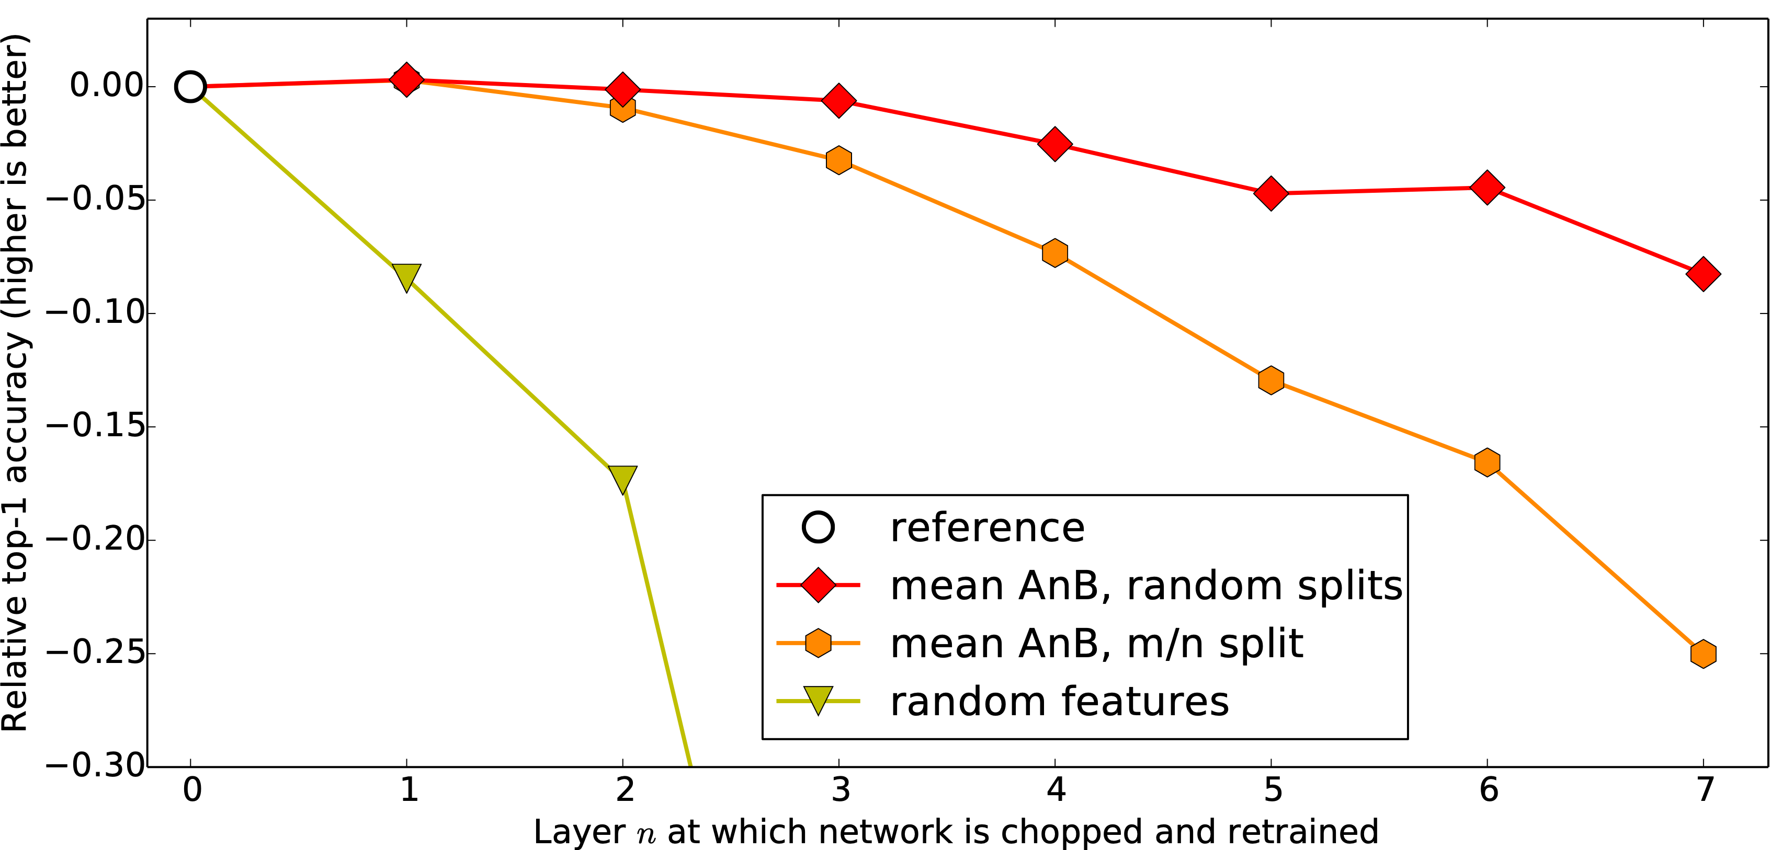
Similar A/B

Slide 34
Similar A/B
Dissimilar A/B

Slide 35
Similar A/B
Random
(Jarret et al. 2009)
Dissimilar A/B

Slide 36
Conclusion

Slide 37
Conclusions
fine-tuning helps
co-adaptation
specificity
Measure general to specific transition layer by layer
Transferability governed by:
lost co-adaptations
specificity
difference between base and target dataset
Fine-tuning helps even on large target dataset

Slide 38
Thanks

